Slide 1
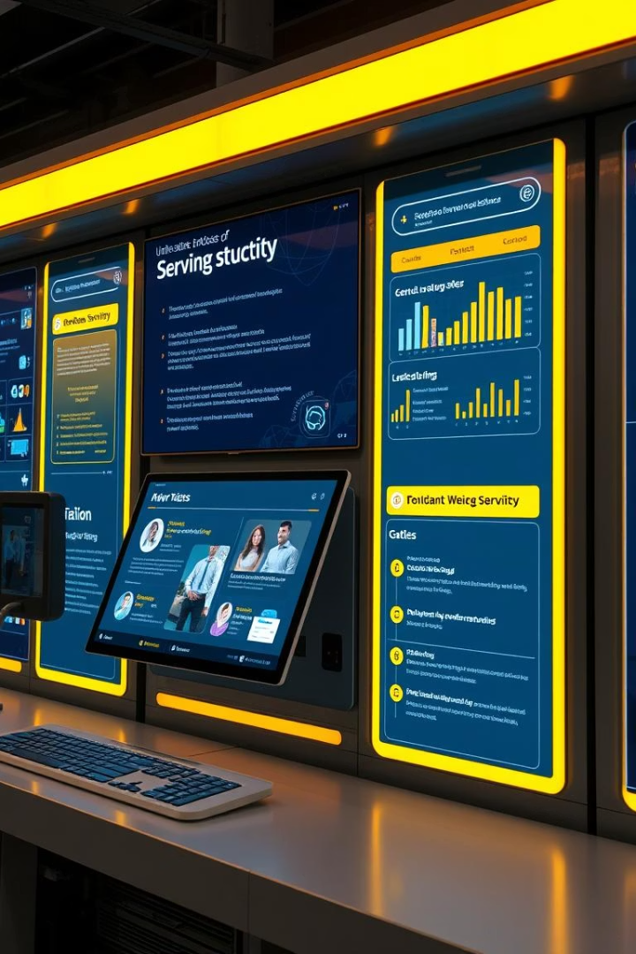

Internship & Job Placement System
This project delivers a university internship and job placement system.
It follows MIS best practices across three phases.
by Mutoni Patience

Slide 2

Phase I: Problem Definition
Core Problem
Stakeholders
Manual matching causes missed opportunities and low efficiency.
Students, career services, employers, and university leadership.
Goals
Automate matching, improve placements, and provide data insights.

Slide 3
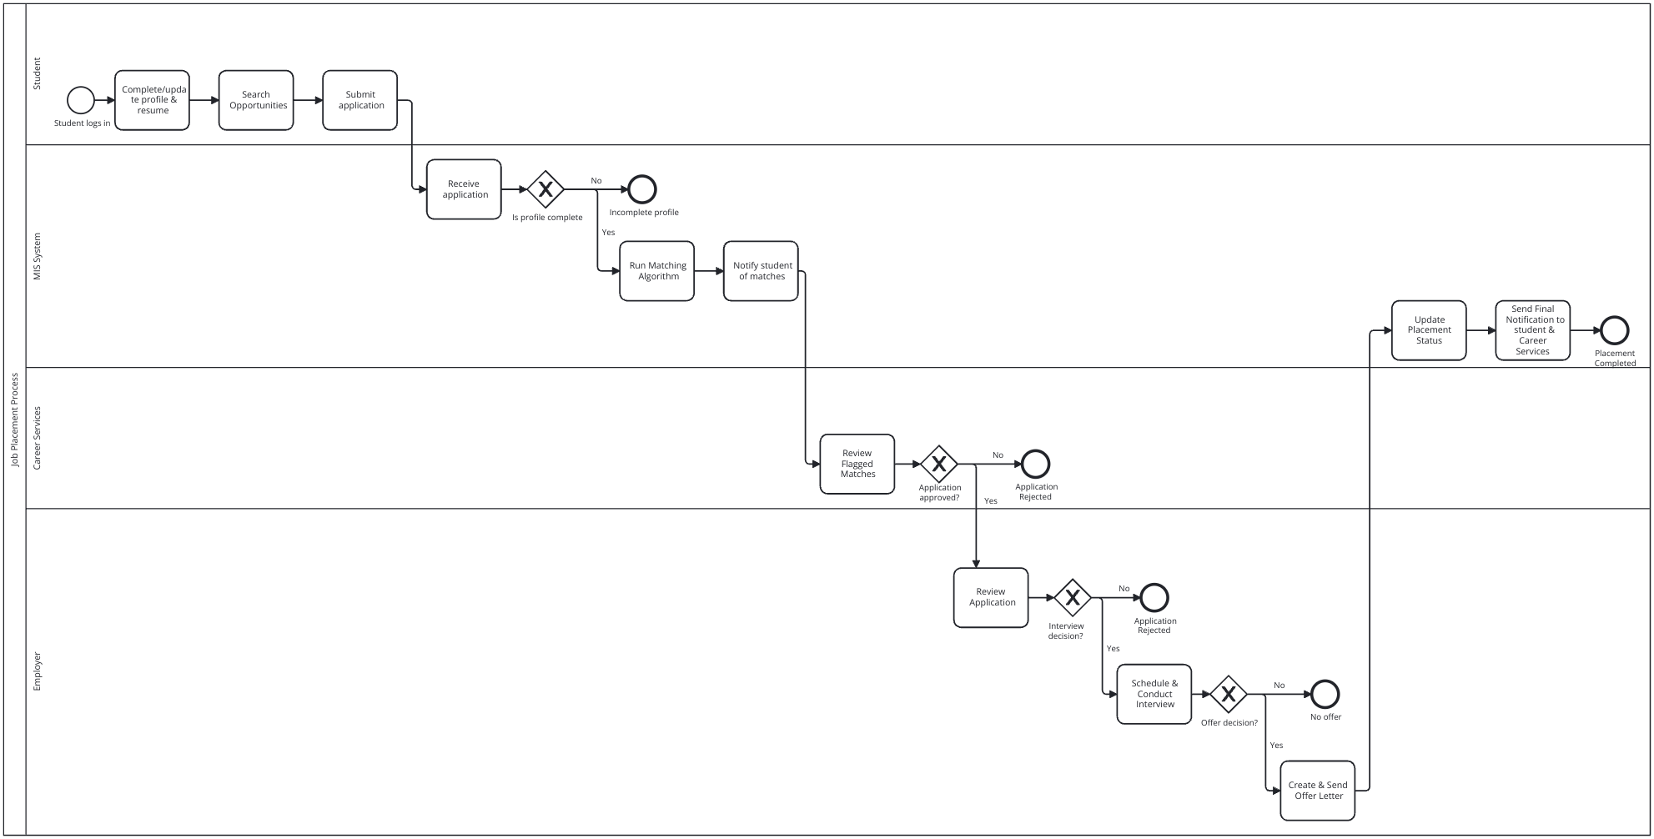
Phase II: Business Process Model (BPMN)
Process Mapping
Key Features
Swimlanes cover Student, MIS System, Career Services, Employer.
Tasks, decisions, and message flows automate matching and notifications.
Outcome
Real-time status updates and streamlined application processes.

Slide 4
Phase III: Logical Model Design
ER Diagram
Data Integrity
Scalability
Entities: STUDENT, EMPLOYER, JOB_POSTING, APPLICATION, INTERVIEW, OFFER.
Primary keys, foreign keys, and constraints enforce business rules.
Supports multiple interviews and single-offer enforcement.

Slide 5

PL/SQL Implementation Snapshots
Tables
Sequences
Procedures
Functions
Job posting and employer tables with keys and references.
Retrieve student email by ID.
Auto-incrementing IDs for students and jobs.
Example: Add student procedure for inserting records.

Slide 6

Additional PL/SQL Features
Packages
Package Testing
Triggers
Window Functions
Grouped procedures and functions for modular code.
Sample test adding a student and fetching email.
Auto-lowercase emails before insert.
Ranking students by GPA.
Window Functions
Counting jobs per employer.

Slide 7
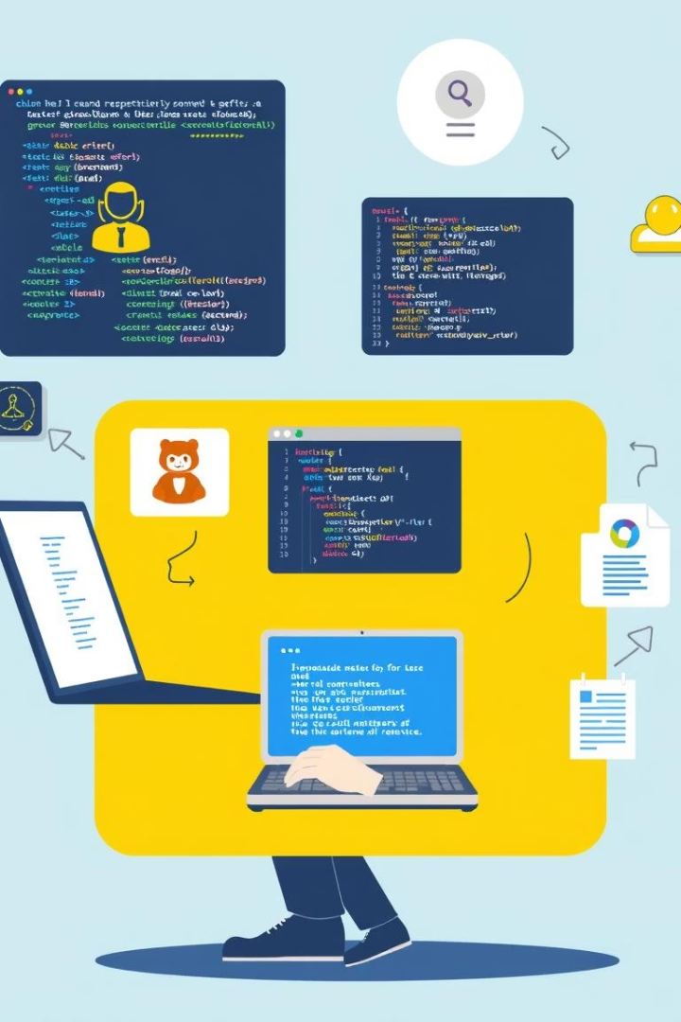




How to Use This Repository
Clone Repo
Download the private repository to your local machine.
Review Files
Read markdown files for narratives, diagrams, and models.
View Images
Open images folder for diagrams and code snapshots.
Share & Document
Use as documentation or share with stakeholders.
All diagrams were created in draw.io and exported as PNG.

